Slide 1
Entity Relationship (ER) Modeling
TIF 2302

Slide 2
Objectives
The main characteristics of entity relationship components
How relationships between entities are defined, refined, and incorporated into the database design process
How ERD components affect database design and implementation
That real-world database design often requires the reconciliation of conflicting goals

Slide 3
Entity Relationship Model (ERM)
Basis of an entity relationship diagram (ERD)
ERD depicts the:
Conceptual database as viewed by end user
Database’s main components
Entities
Attributes
Relationships

Slide 4
Entity/Relationship Diagrams
E/R Models are often represented as E/R diagrams that
Give a conceptual view of the database
Are also independent of the choice of DBMS
Can identify some problems in a design

Slide 5
E-R Notation
Various conventions
Chen
Mostly American
Manga guide
Crow’s Foot
Mostly British
Many others

Slide 6
Entities
Entity
Group of objects with same properties, identified by enterprise as having an independent existence.
Entity occurrence
Uniquely identifiable object of an entity type.
Entity - Refers to the entity set and not to a single entity occurrence

Slide 7
Diagramming Entities
In an E/R Diagram, an entity is usually drawn as a box with rounded corners.
The box is labelled with the name of the entity.

Slide 8
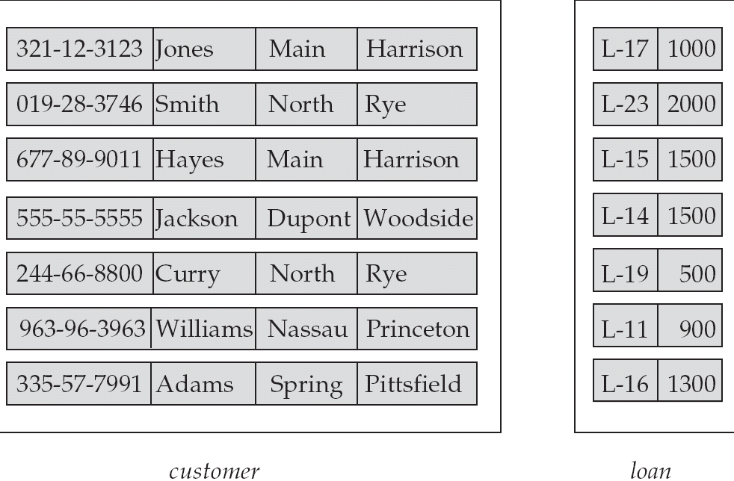
Diagramming Entities
customer-id customer- customer- customer- loan- amount
name street city number

Slide 9
ER diagram of Customer and Loan entity
Customer
Loan

Slide 10
Attributes
Characteristics of entities
Required attribute: Must have a value, cannot be left empty
Optional attribute: Does not require a value, can be left empty
Domain - Set of possible values for a given attribute
Identifiers: One or more attributes that uniquely identify each entity instance

Slide 11
Diagramming Attributes
In an E/R Diagram attributes may be drawn as ovals
Each attribute is linked to its entity by a line
The name of the attribute is written in the oval

Slide 12
ER diagram of Customer and Loan entity
Customer
Loan

Slide 13
Diagramming Attributes
Customer-name
Customer-street
Loan-Number
Amount
Customer-id
Customer-city
Customer
Loan

Slide 14
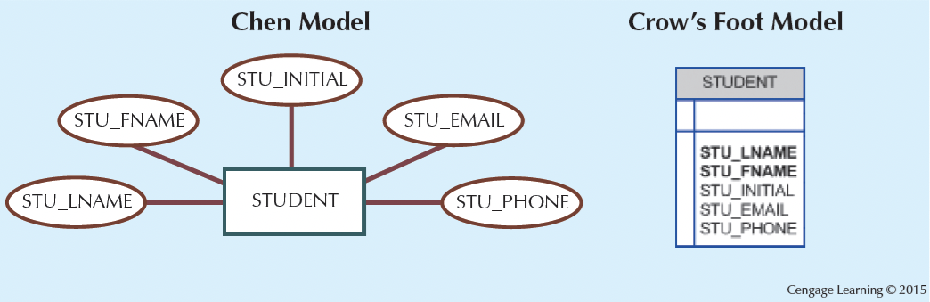
The Attributes of the Student Entity: Chen and Crow’s Foot

Slide 15
Attributes
Composite identifier: Primary key composed of more than one attribute
Attributes can be classified as:
Simple and composite attributes.
Single-valued and multi-valued attributes.
Derived attributes

Slide 16
Simple and Composite Attributes
Simple attribute
Attribute that cannot be subdivided
Example; Gender
Composite attribute:
Attribute that can be subdivided to yield additional attributes
example,
Name : First_name, Middle_name, Last_name
Address : Street, City, Postcode

Slide 17
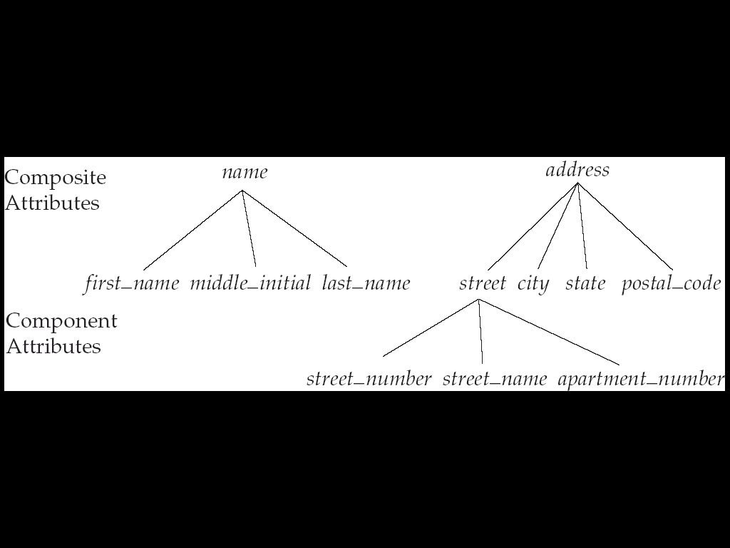
Simple and Composite Attributes

Slide 18
Diagramming Simple and Composite Attributes
Nama
Jenis_Kelamin
Nama_Depan
Nama_Belakang
Nama_Tengah
(a) Atribut sederhana
(b) Atribut komposit

Slide 19
Diagramming Simple and Composite Attributes
Nomor_Mahasiswa
Nama
Nama_Depan
Mahasiswa
Nama_Tengah
Nama_Belakang
Jenis_Kelamin
Tanggal_Lahir
Entity yang melibatkan atribut kompisit dan sederhana

Slide 20
Single-valued attributes
Single-valued attribute
Attribute that has only a single value
Customer_ID

Slide 21
Multi-valued attributes
Multivalued attributes
Attributes that have many values and require creating:
Several new attributes, one for each component of the original multivalued attribute
A new entity composed of the original multivalued attribute’s components
Hobby
Multi-valued attribute

Slide 22
Diagramming Single-valued and multi-valued attributes
Kode_Pelanggan
Nama
Pelanggan
Telepon
Alamat
Jalan
Kota
Kode_Pos

Slide 23
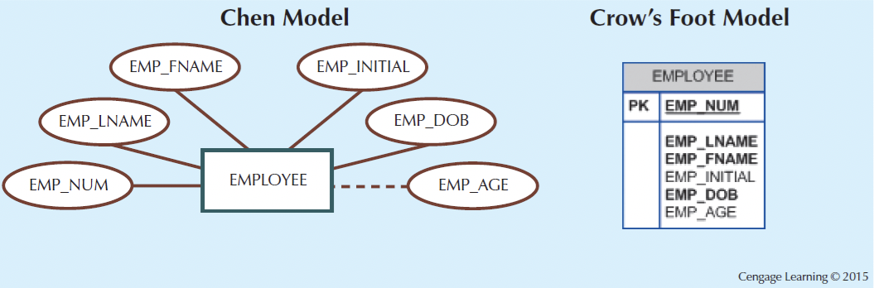
Derived Attribute
Attribute whose value is calculated from other attributes
Derived using an algorithm

Slide 24
Diagramming Derived Attribute
Kode_Pasien
Nama
PASIEN
Usia
Tanggal_Lahir
entity set yang melibatkan atribut turunan yaitu usia

Slide 25
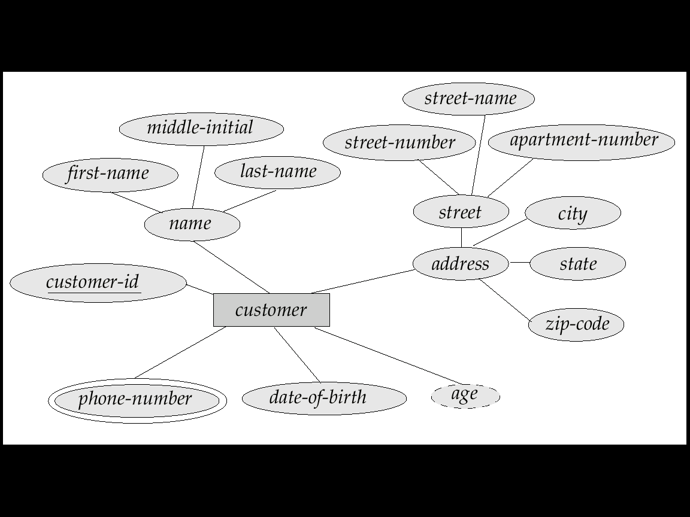
E-R Diagram With Composite, Multivalued, and Derived Attributes

Slide 26
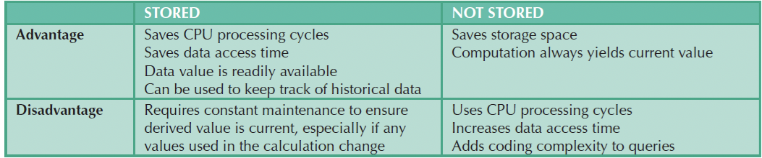
Advantages and Disadvantages of Storing Derived Attributes

Slide 27
Relationship
Association between entities that always operate in both directions
Participants: Entities that participate in a relationship
Connectivity: Describes the relationship classification
Cardinality: Expresses the minimum and maximum number of entity occurrences associated with one occurrence of related entity

Slide 28
Diagramming Relationship
Each relationship is shown as a diamond and line connecting the associated entity, labeled with the name of the relationship
Normally, a relationship is named using a verb(Supervises or Manages)

Slide 29
Relationship
Relationship occurrence
Uniquely identifiable association, which includes one occurrence from each participating entity type.

Slide 30
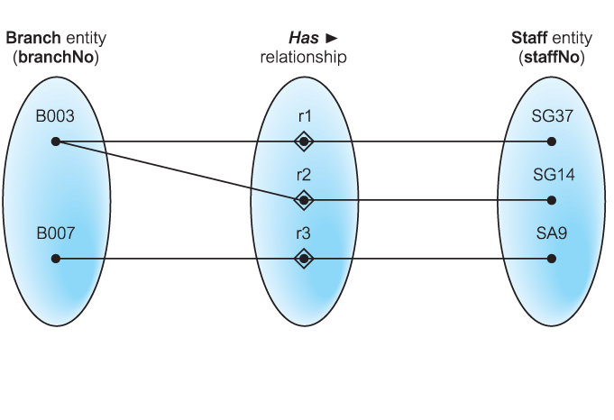
Semantic net of Has relationship type

Slide 31
ER diagram of Customer and Loan entity
Customer
Loan

Slide 32
Diagramming Attributes
Customer-name
Customer-street
Loan-Number
Amount
Customer-id
Customer-city
Customer
Loan

Slide 33
Diagramming Relationship
Customer-name
Customer-street
Loan-Number
Amount
Customer-id
Customer-city
Borrower
Customer
Loan

Slide 34
Relationship
Degree of a Relationship
Number of participating entities in relationship.
Relationship of degree :
two is binary
three is ternary
four is quaternary
Unary/recursive
Generally, most relationship sets in a database system are binary or degree two

Slide 35

Binary relationship called POwns

Slide 36
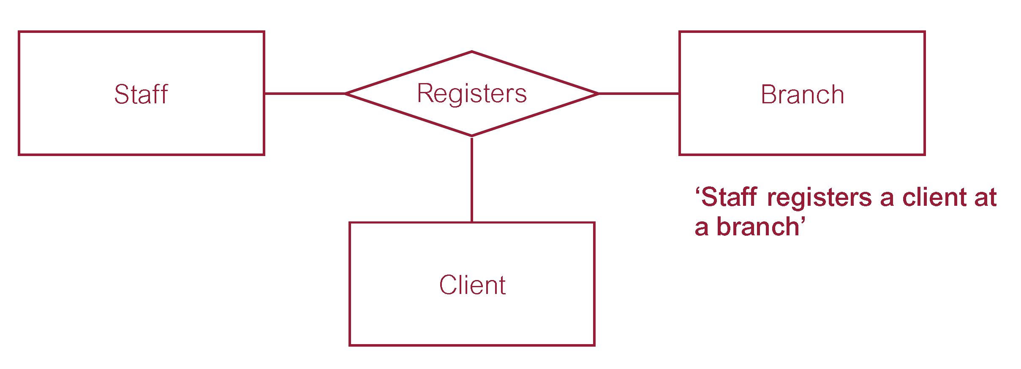
Ternary relationship called Registers

Slide 37
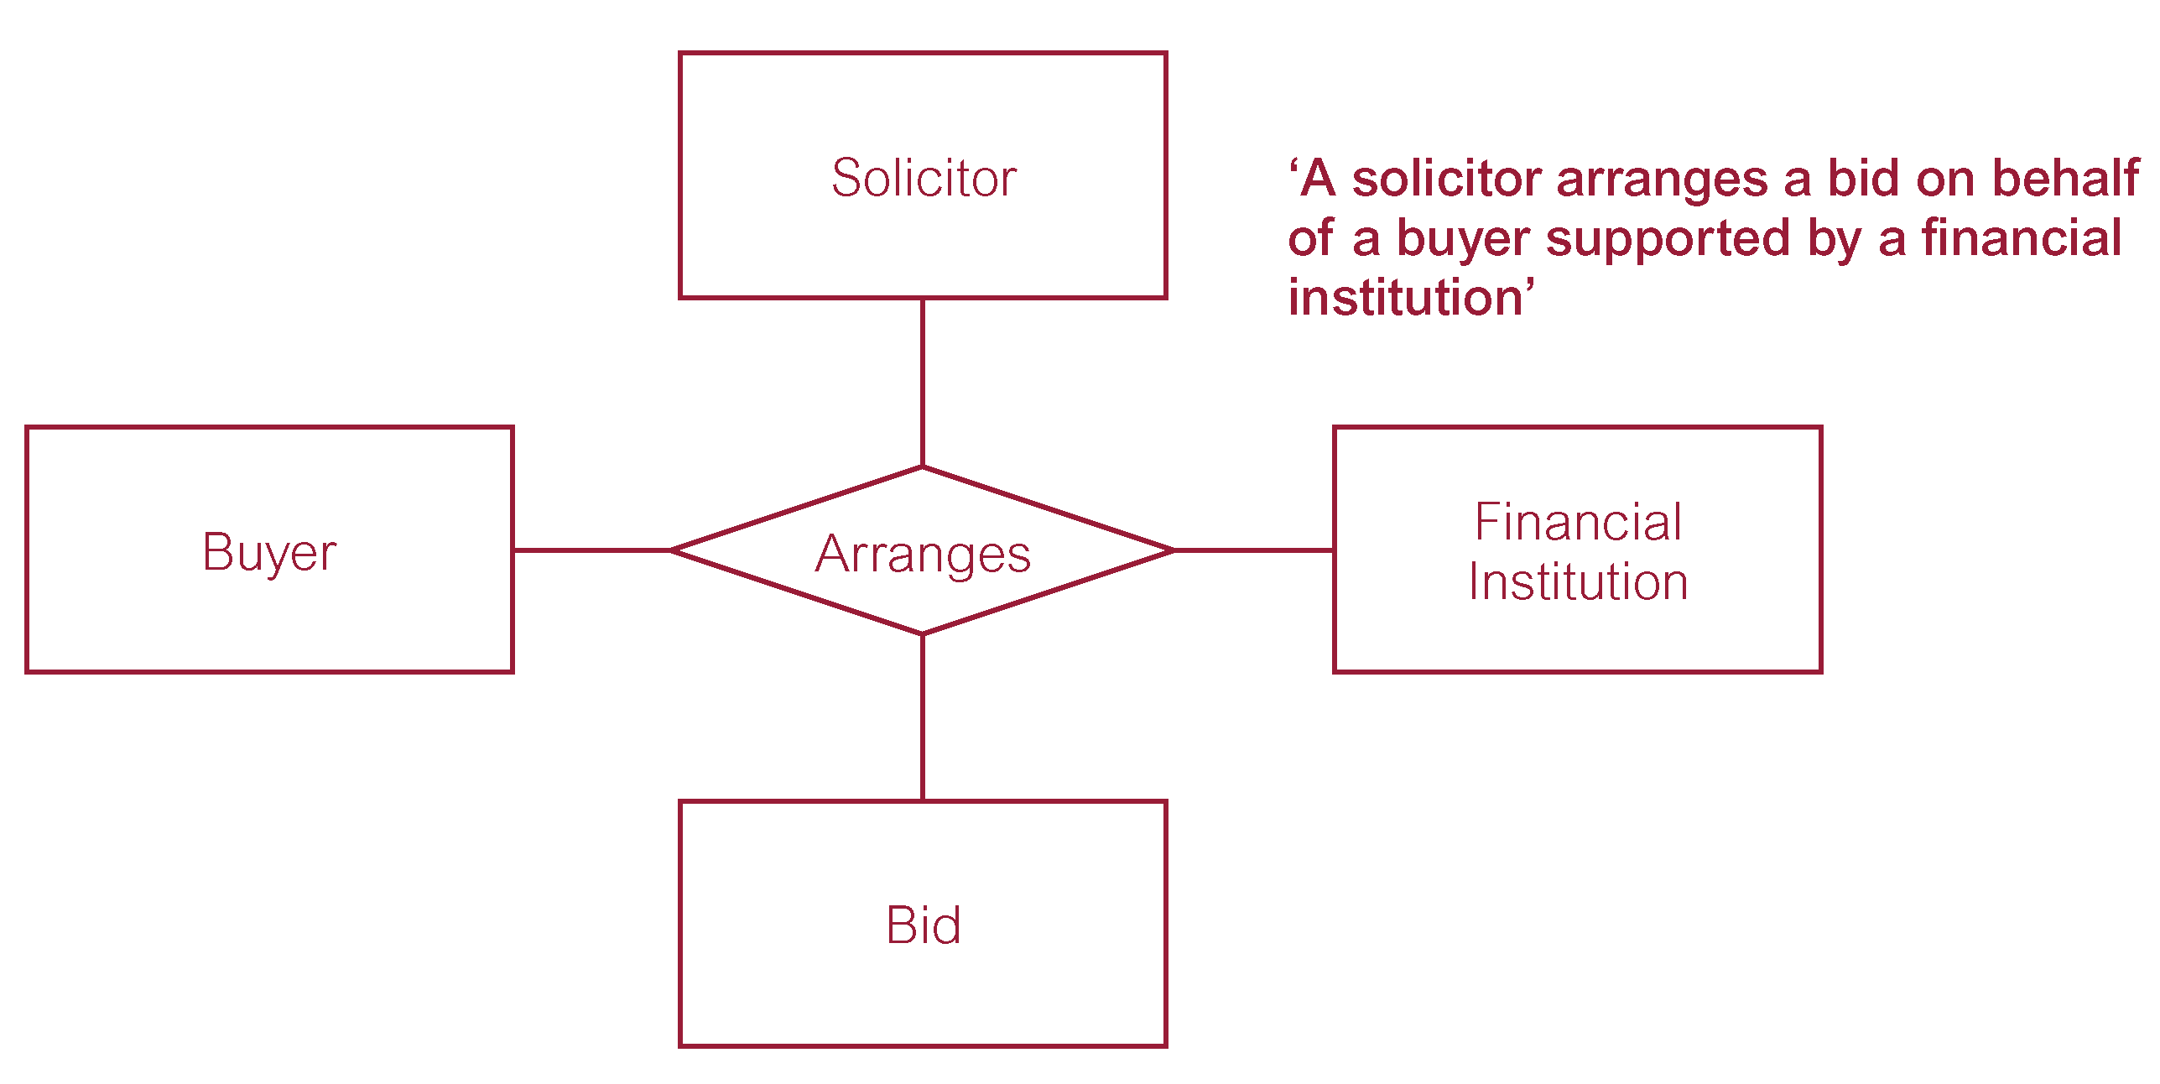
Quaternary relationship called Arranges

Slide 38
Relationship
Recursive Relationship
Relationship type where same entity type participates more than once in different roles.
Relationships may be given role names to indicate purpose that each participating entity type plays in a relationship

Slide 39
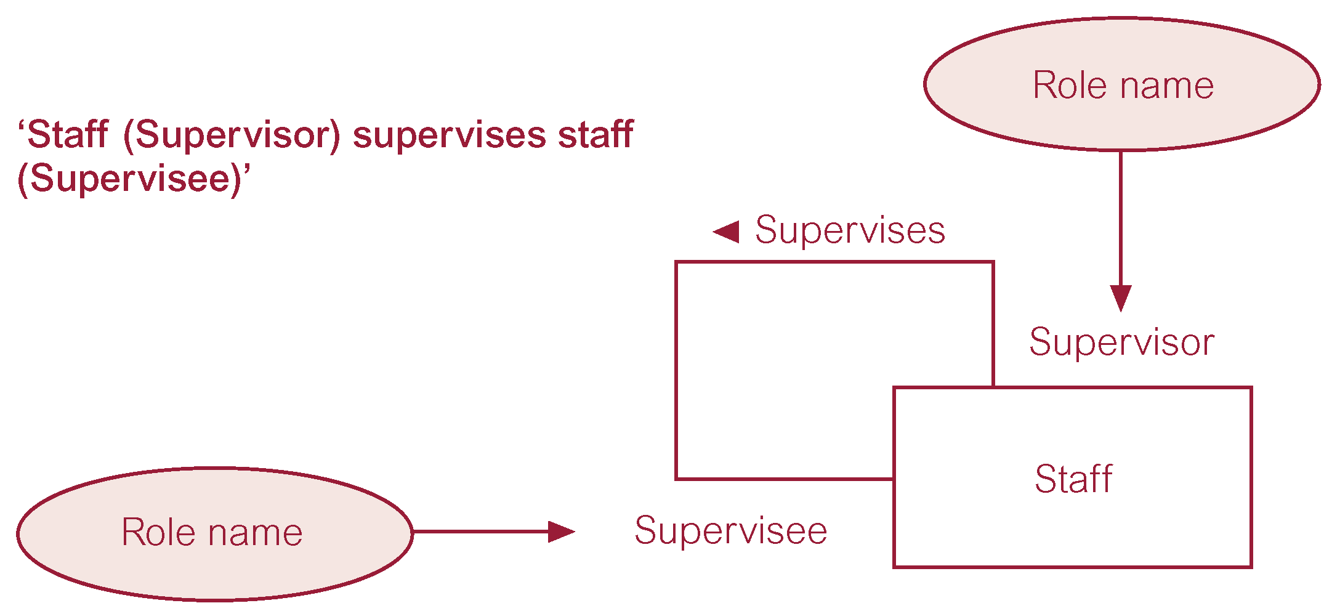
Recursive relationship called Supervises with role names

Slide 40
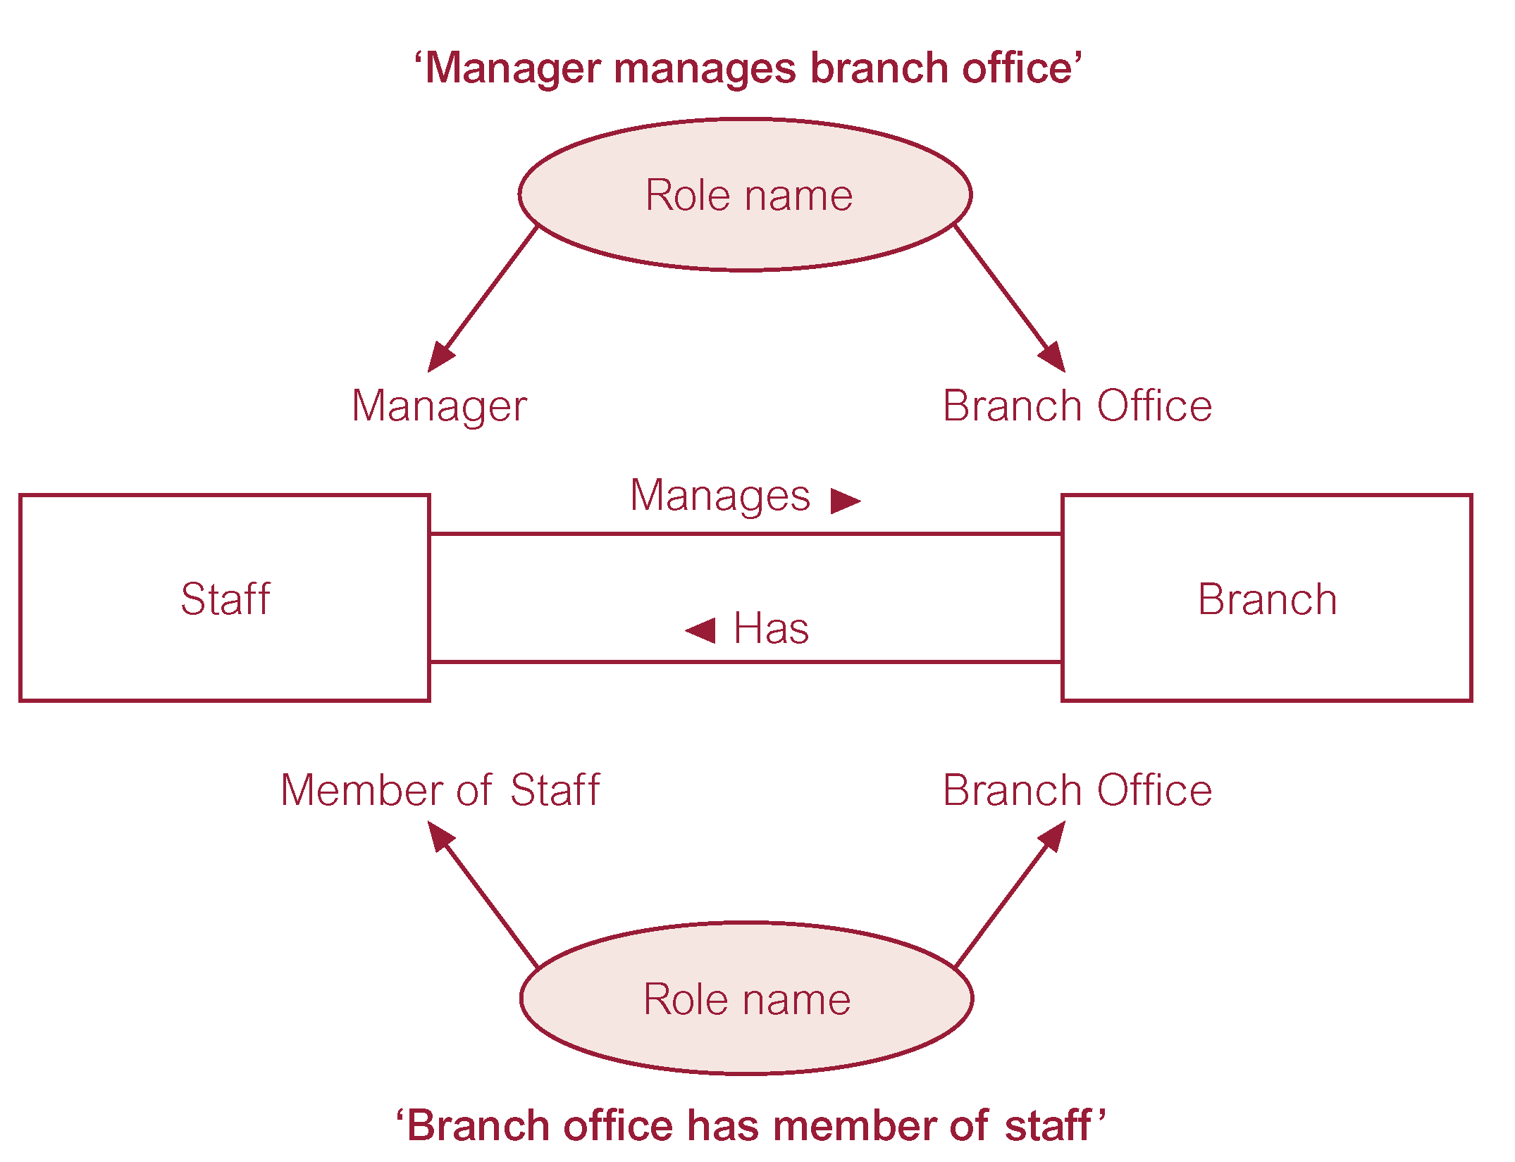
Entities associated through two distinct relationships with role names

Slide 41
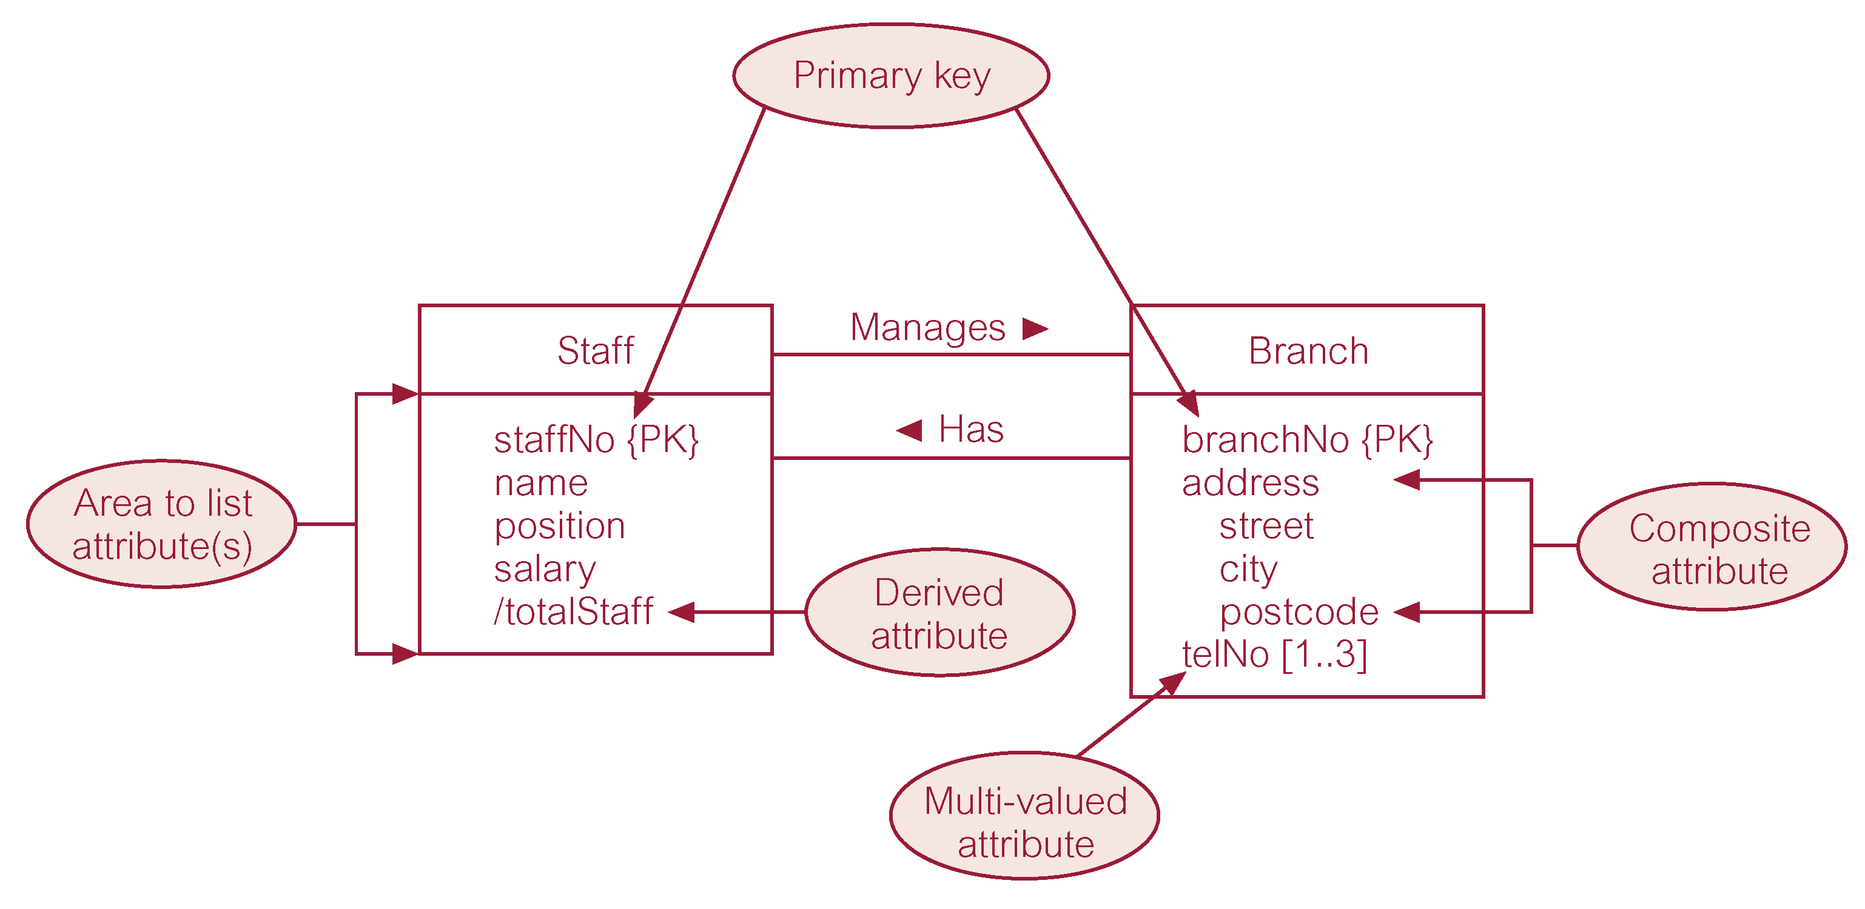
ER diagram of Staff and Branch entities and their attributes

Slide 42
Entity
Strong Entity Set
Entity set that is not existence-dependent on some other entity set
Weak Entity Set
Entity set that is existence-dependent on some other entity set.

Slide 43
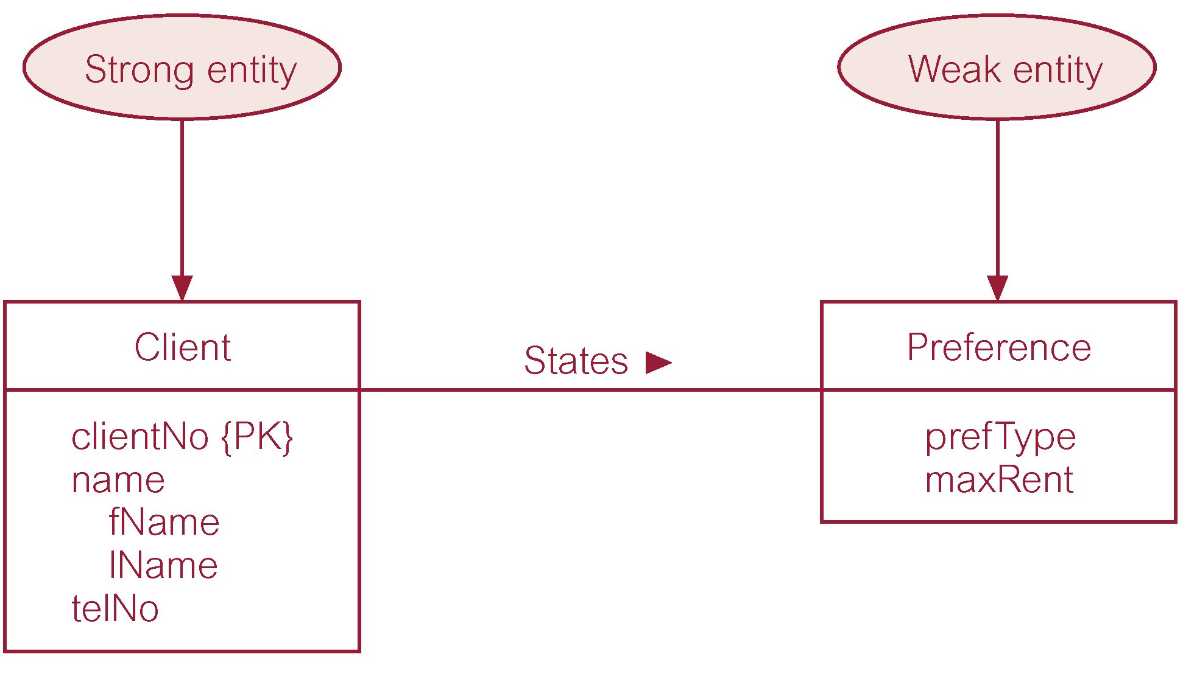
Strong entity set called Client and weak entity set called Preference

Slide 44
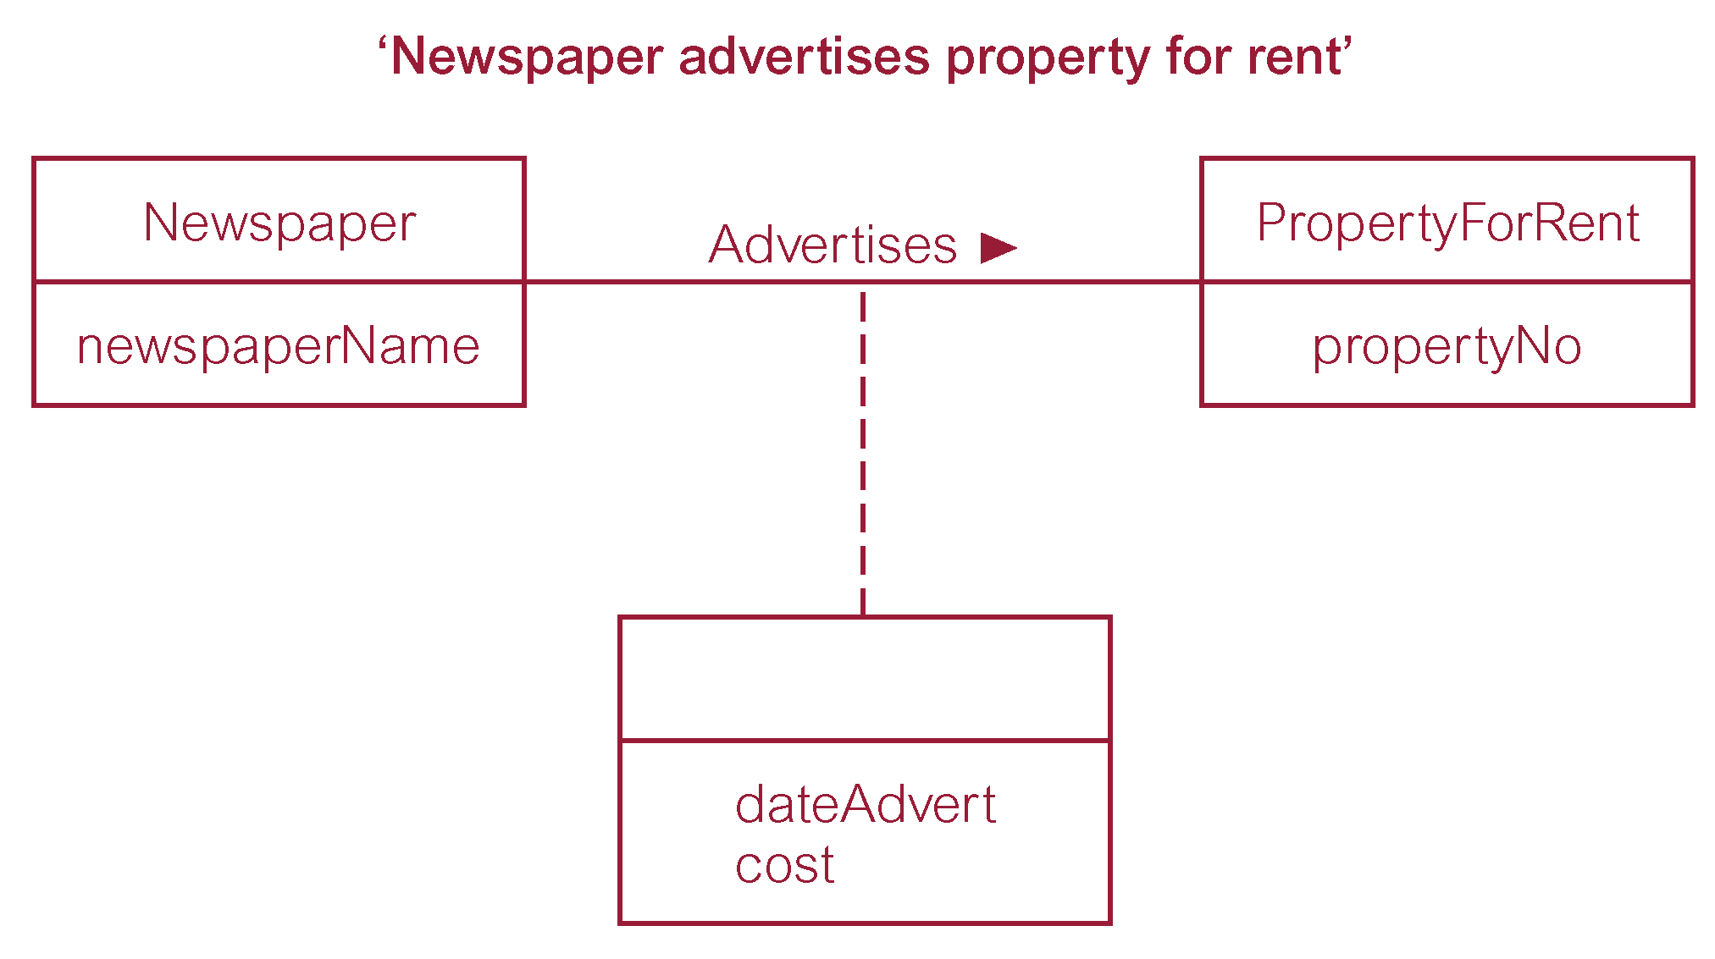
Relationship called Advertises with attributes

Slide 45
Structural Constraints
Main type of constraint on relationships is called multiplicity.
Multiplicity - number (or range) of possible occurrences of an entity type that may relate to a single occurrence of an associated entity type through a particular relationship.
Represents policies (called business rules) established by user or company.

Slide 46
Structural Constraints
The most common degree for relationships is binary.
Binary relationships are generally referred to as being:
one-to-one (1:1)
one-to-many (1:*)
many-to-many (*:*)

Slide 47
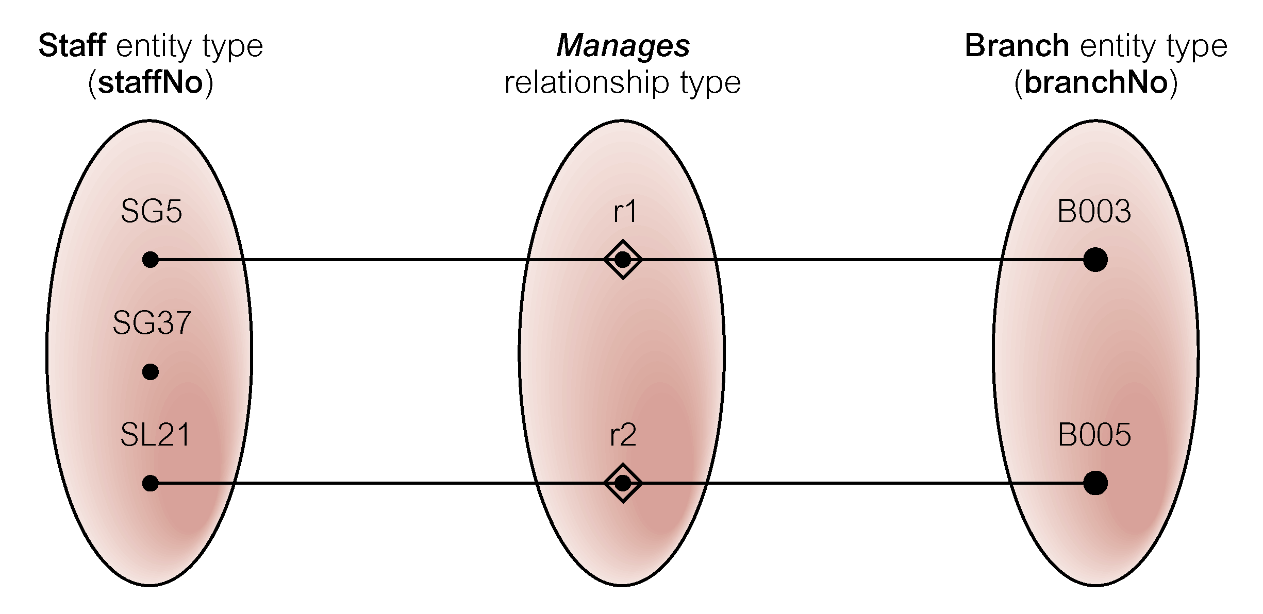
Semantic net of Staff Manages Branch relationship type

Slide 48
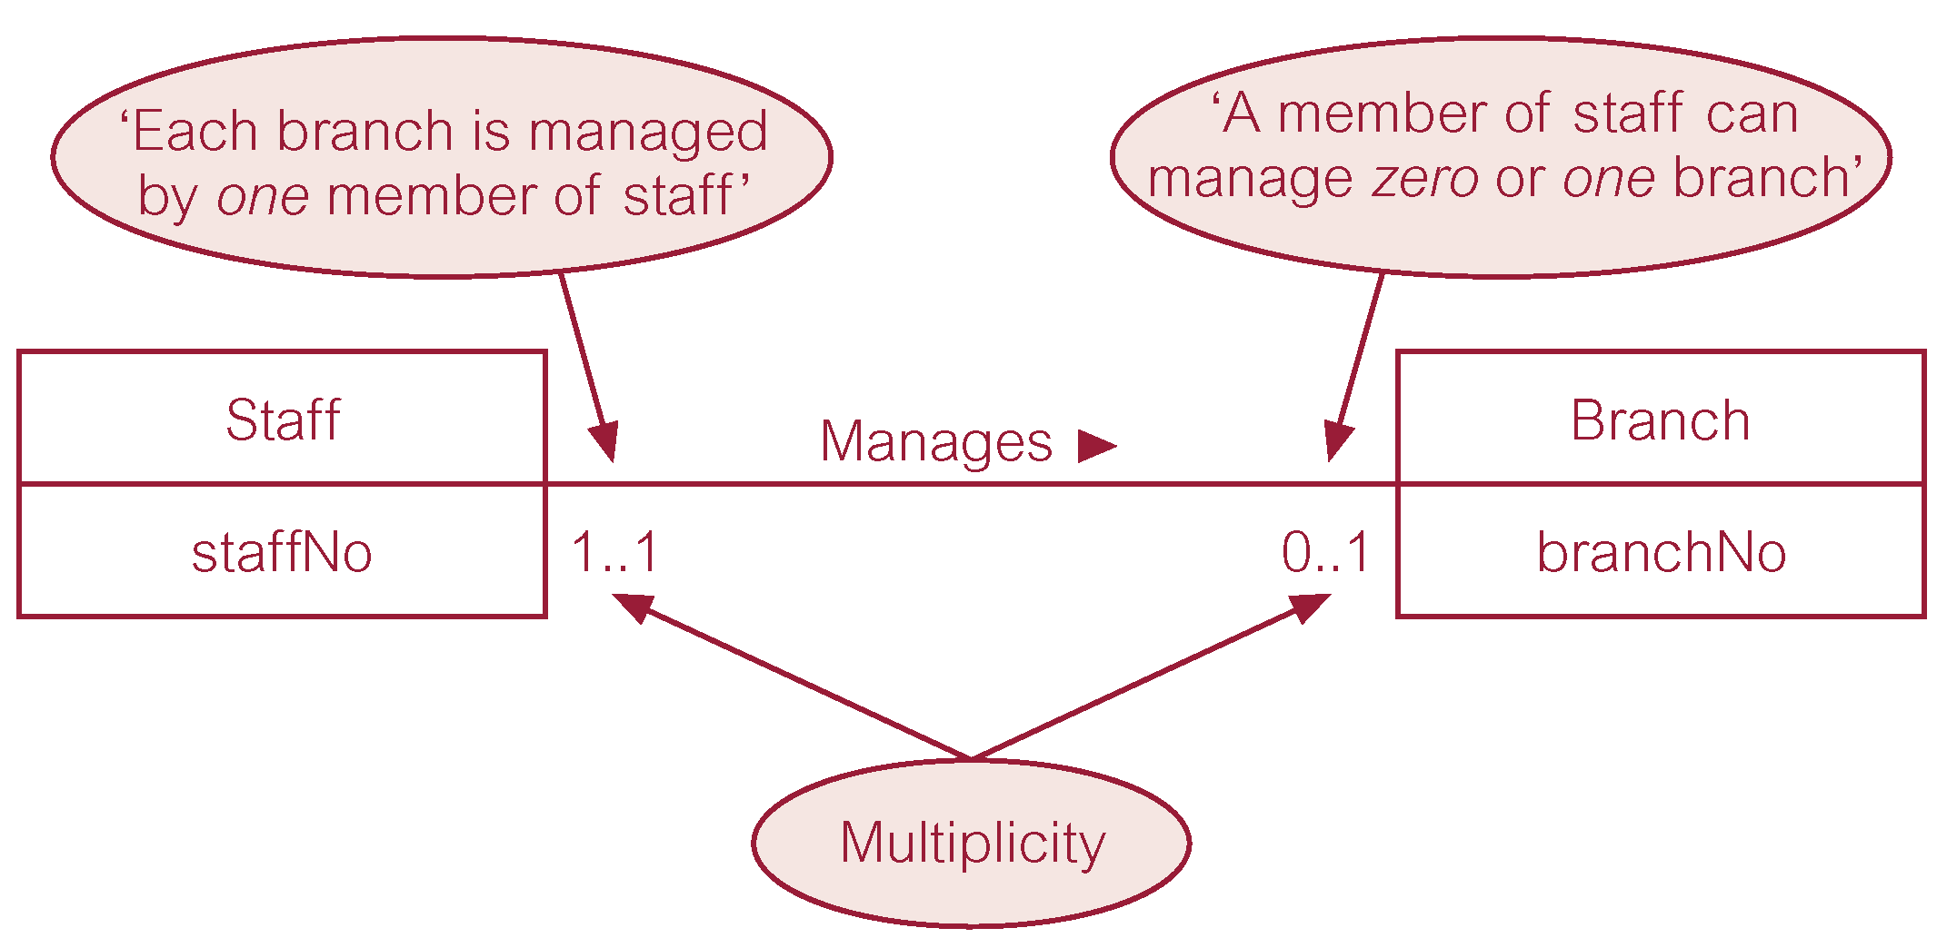
Multiplicity of Staff Manages Branch (1:1) relationship

Slide 49
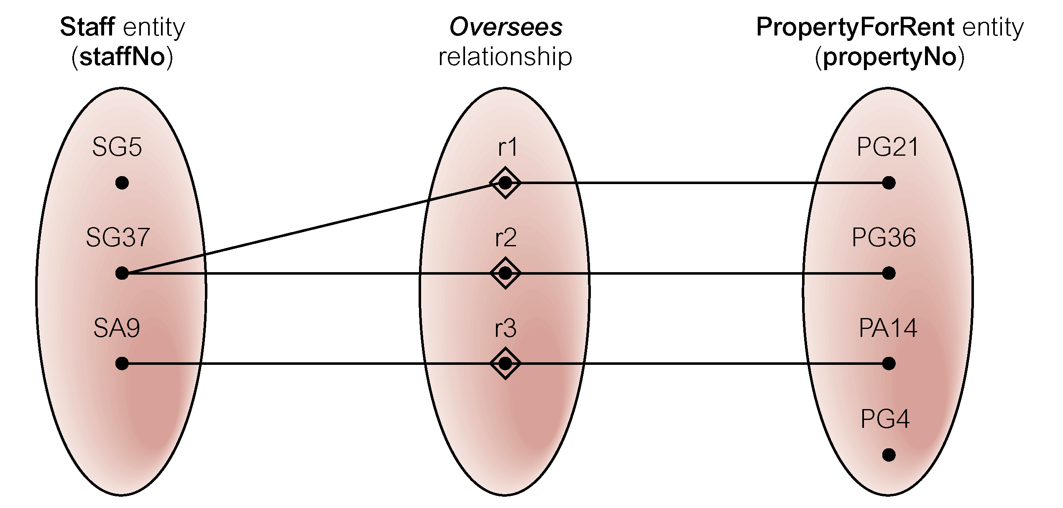
Semantic net of Staff Oversees PropertyForRent relationship type

Slide 50
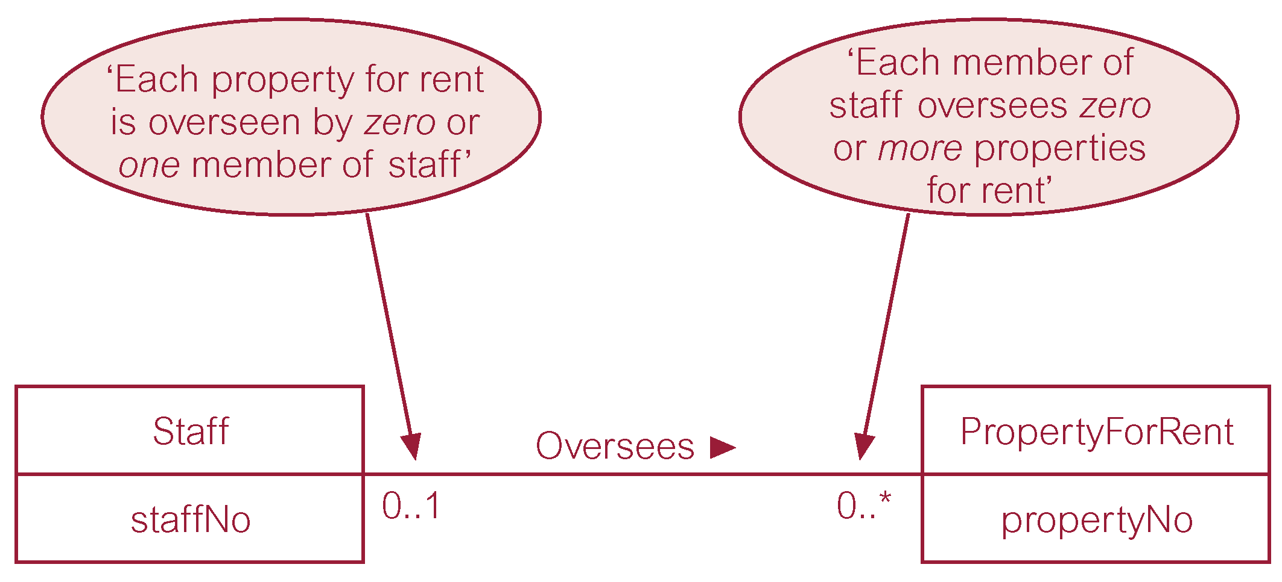
Multiplicity of Staff Oversees PropertyForRent (1:*) relationship type

Slide 51
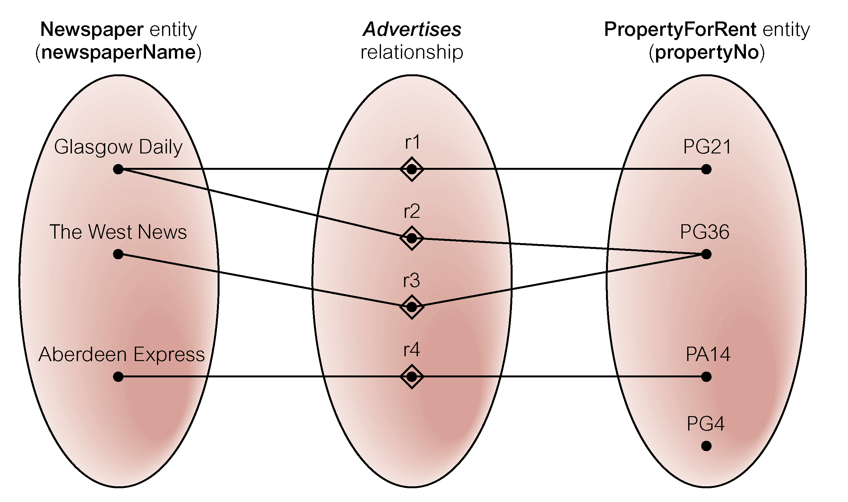
Semantic net of Newspaper Advertises PropertyForRent relationship type

Slide 52
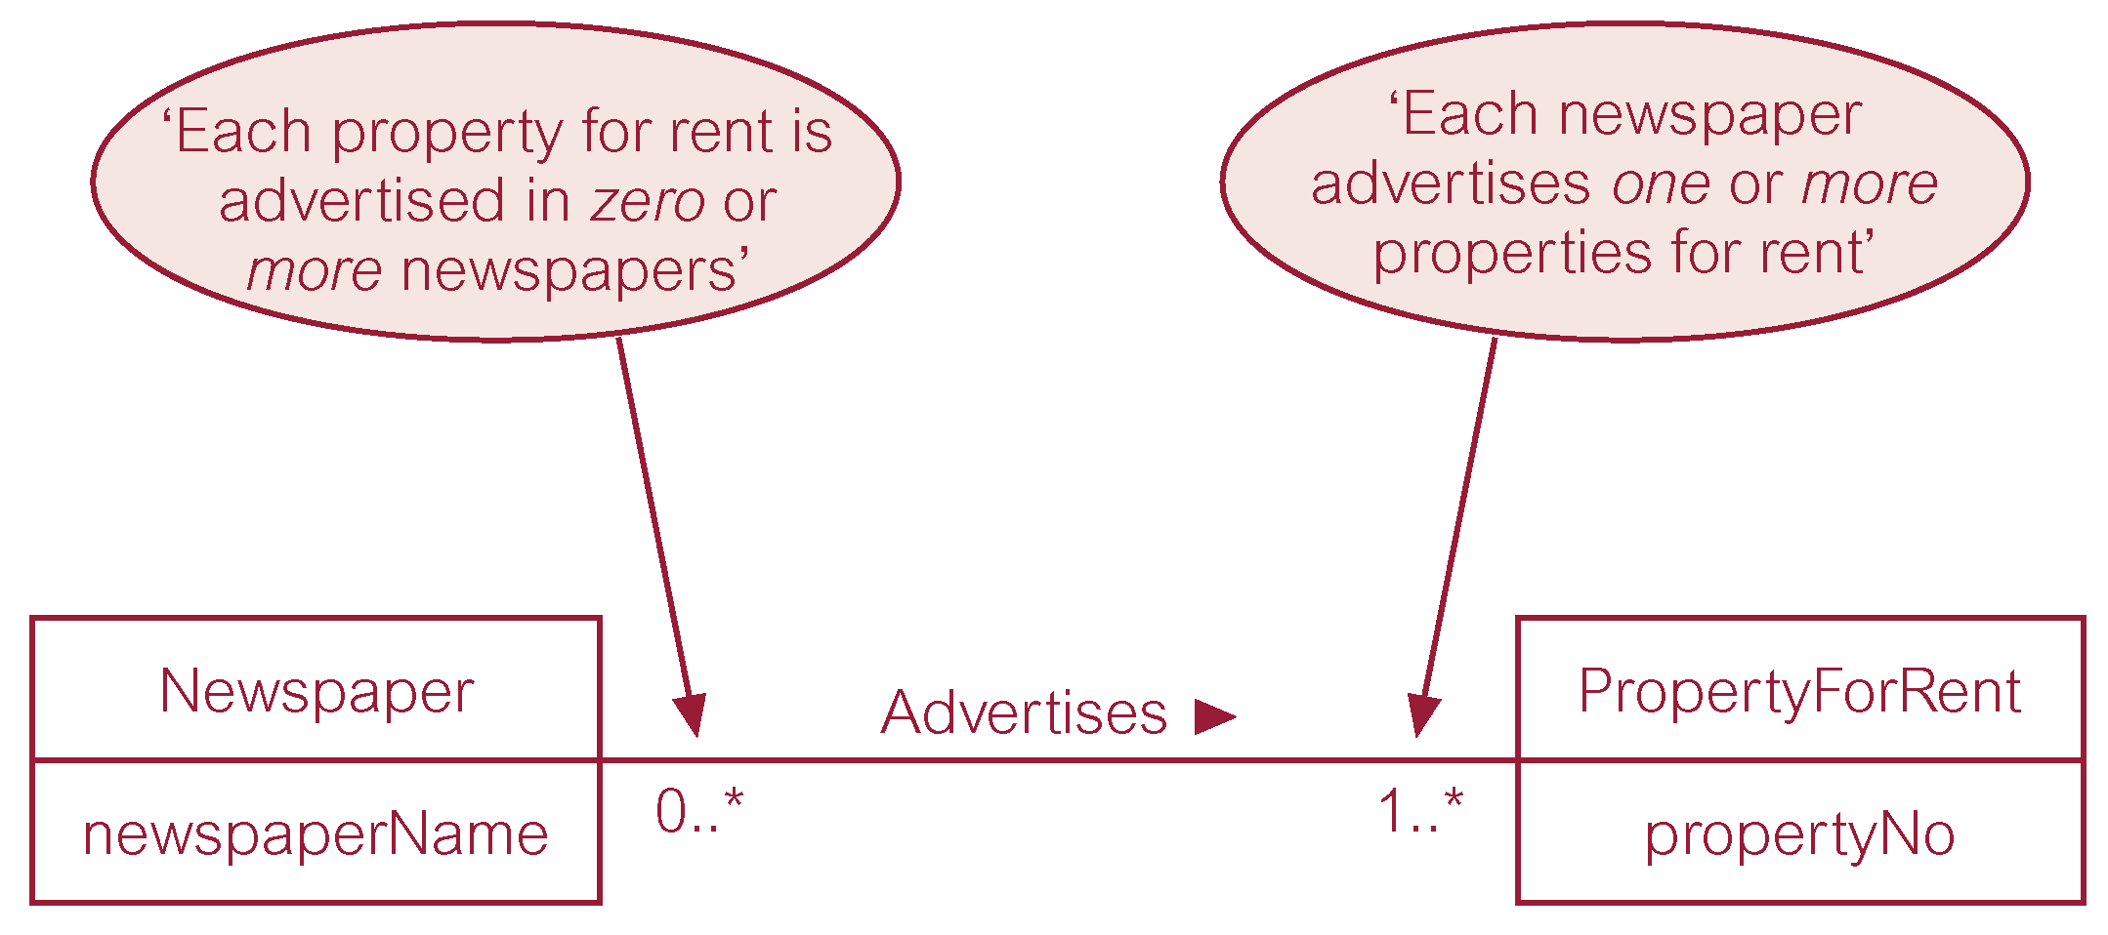
Multiplicity of Newspaper Advertises PropertyForRent (*:*) relationship

Slide 53
Structural Constraints
Multiplicity for Complex Relationships
Number (or range) of possible occurrences of an entity type in an n-ary relationship when other (n-1) values are fixed.

Slide 54
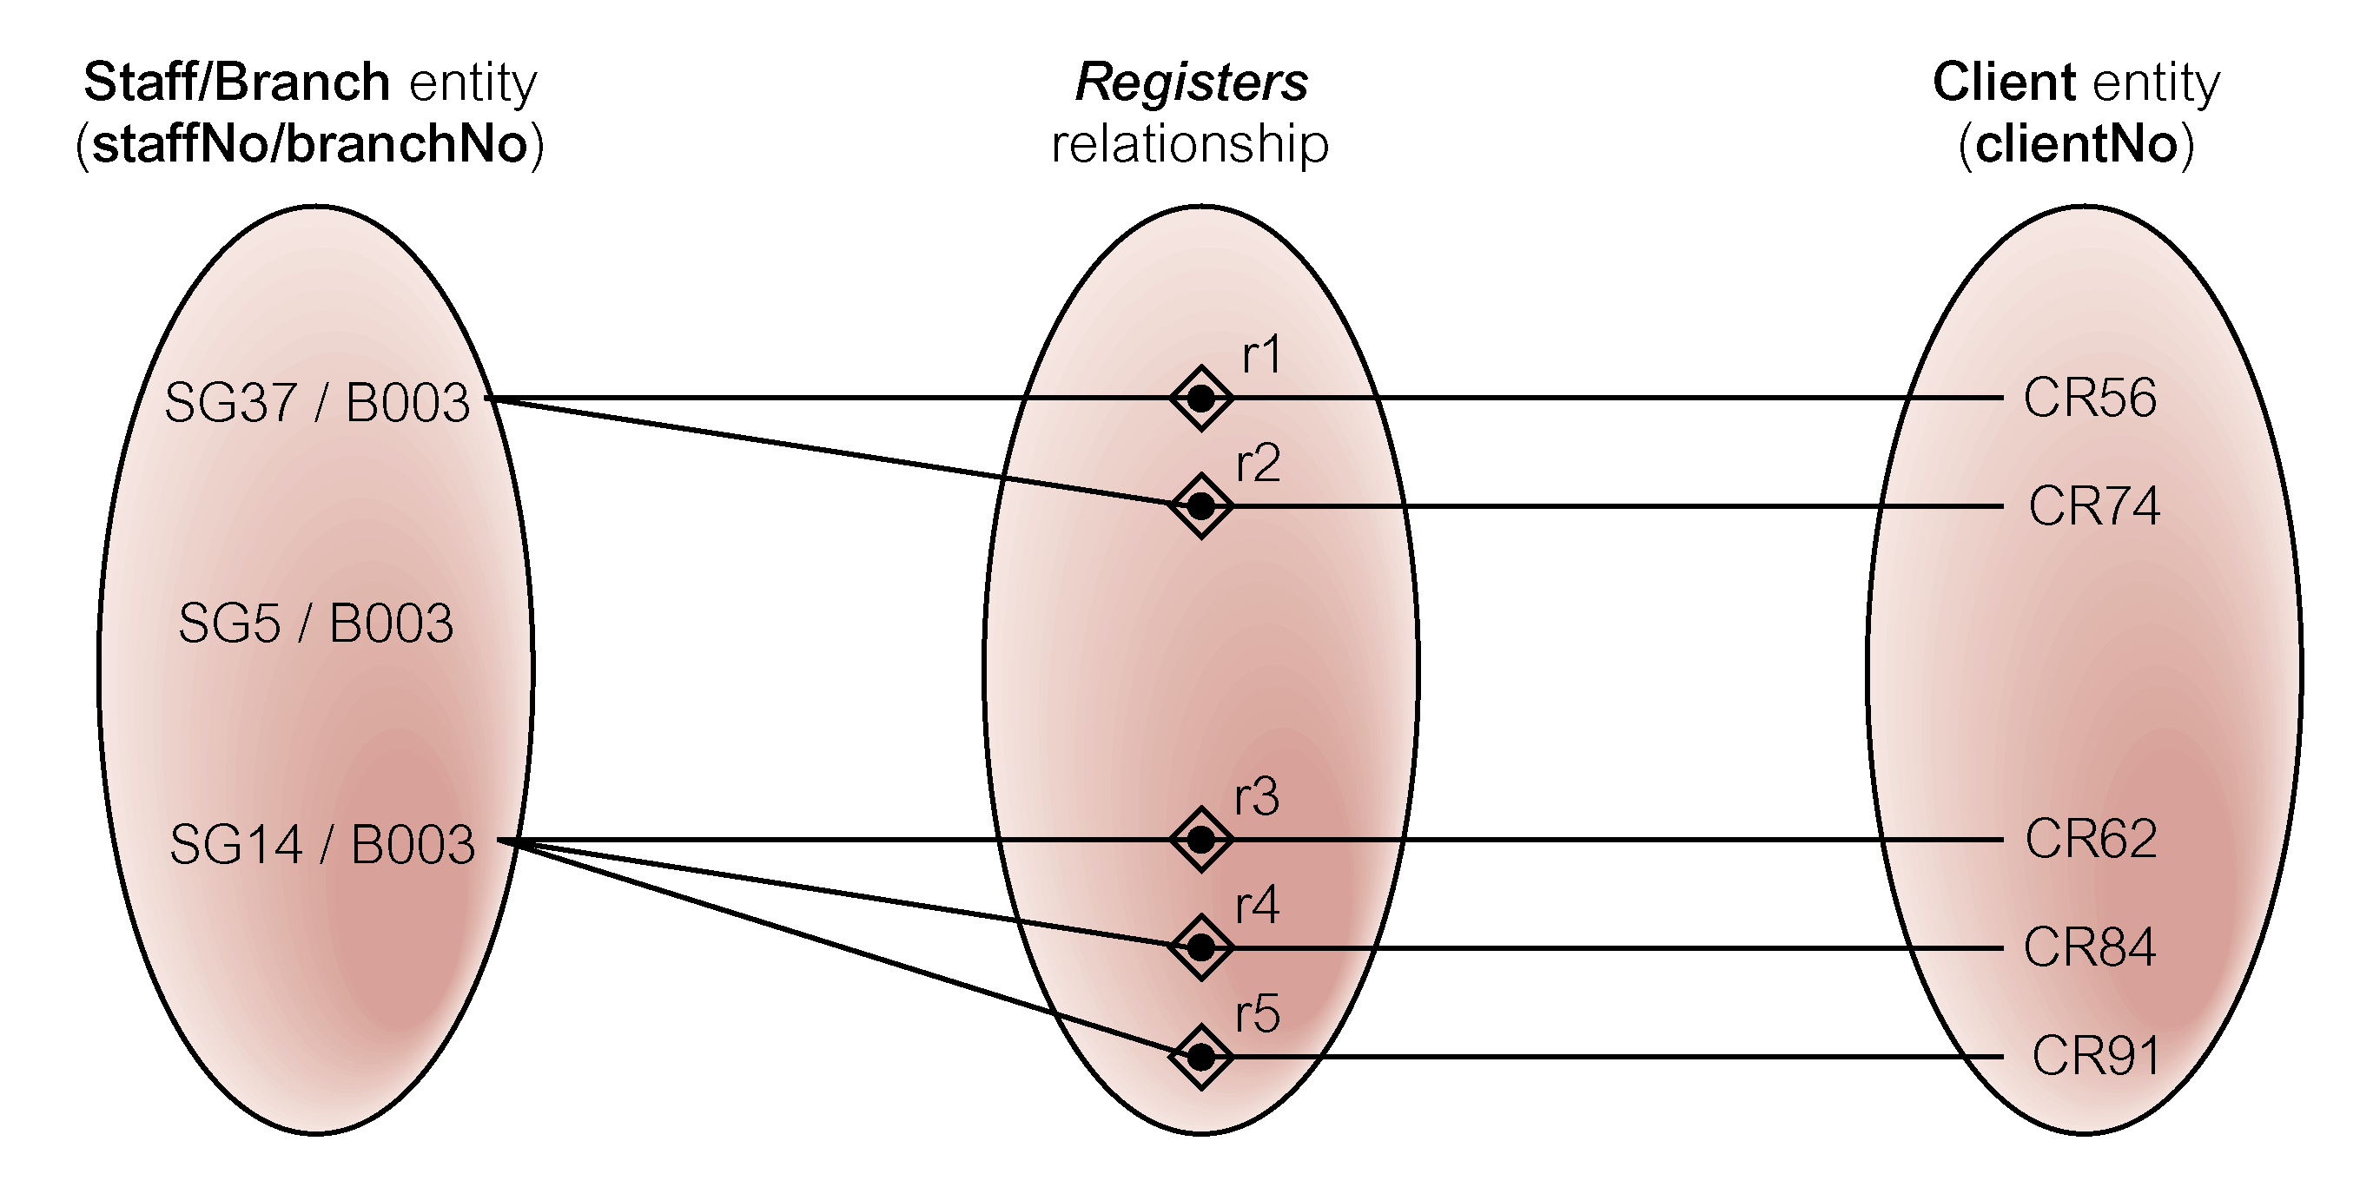
Semantic net of ternary Registers relationship with values for Staff and Branch entities fixed

Slide 55
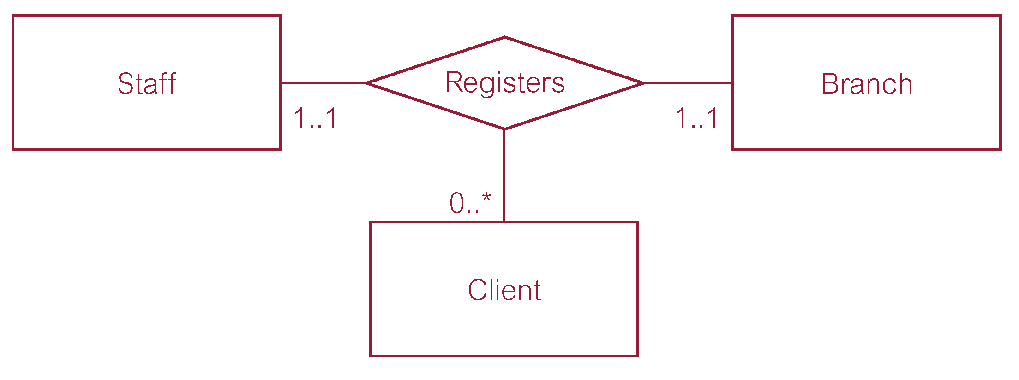
Multiplicity of ternary Registers relationship

Slide 56
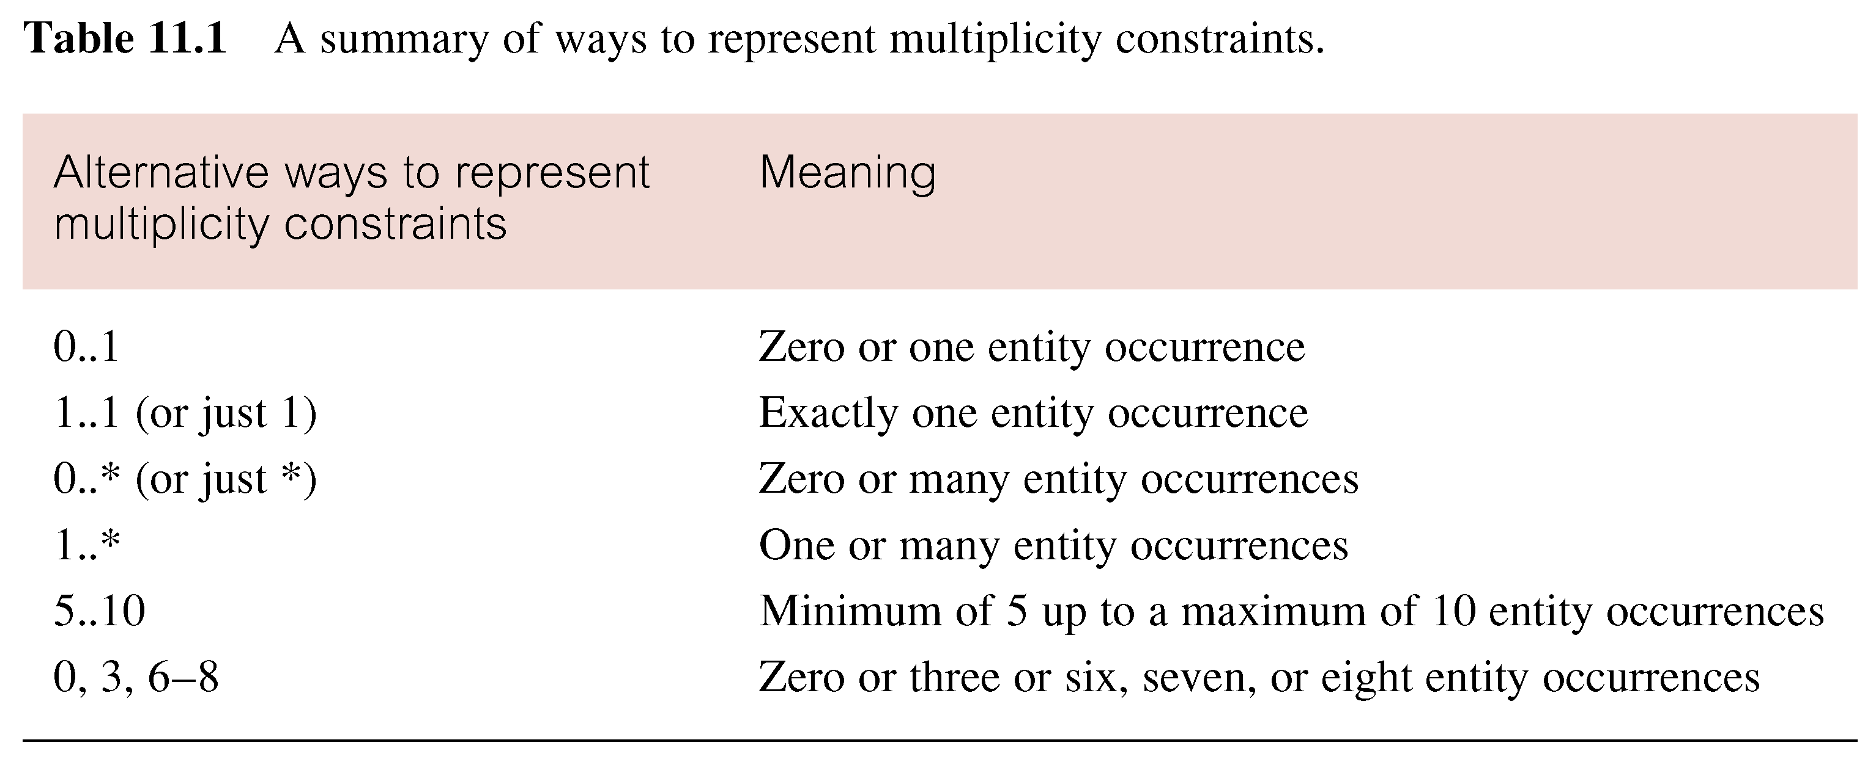
Summary of multiplicity constraints

Slide 57
Structural Constraints
Multiplicity is made up of two types of restrictions on relationships: cardinality and participation.

Slide 58
Structural Constraints
Cardinality
Describes maximum number of possible relationship occurrences for an entity participating in a given relationship type.
Participation
Determines whether all or only some entity occurrences participate in a relationship.

Slide 59
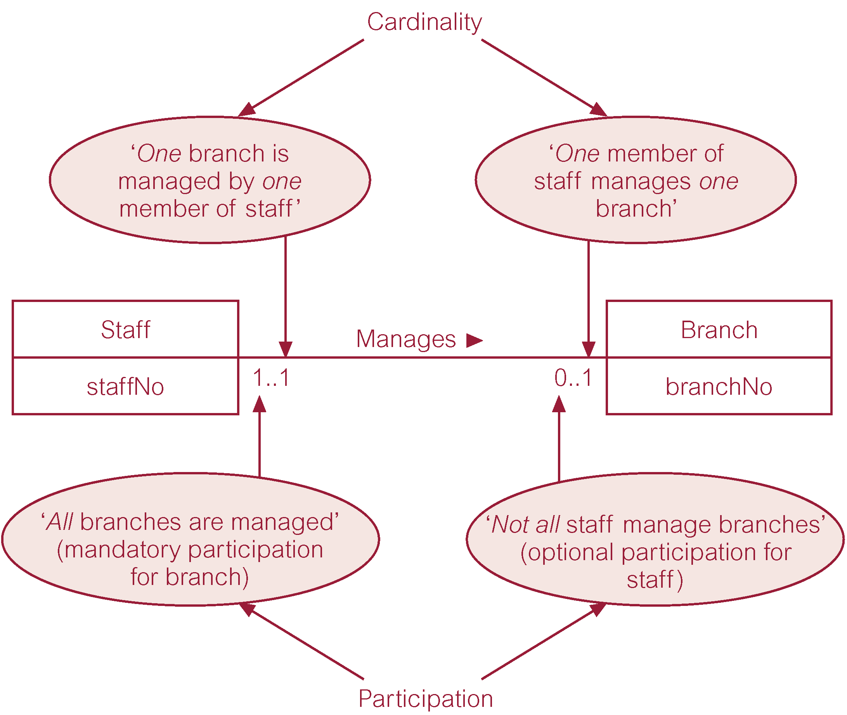
Multiplicity as cardinality and participation constraints

Slide 60
Problems with ER Models
Problems may arise when designing a conceptual data model called connection traps.
Often due to a misinterpretation of the meaning of certain relationships.
Two main types of connection traps are called fan traps and chasm traps.

Slide 61
Problems with ER Models
Fan Trap
Where a model represents a relationship between entity types, but pathway between certain entity occurrences is ambiguous.
Chasm Trap
Where a model suggests the existence of a relationship between entity types, but pathway does not exist between certain entity occurrences.

Slide 62

An Example of a Fan Trap

Slide 63
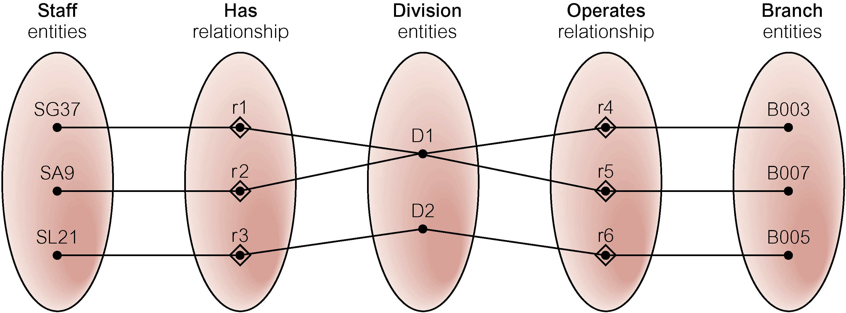
Semantic Net of ER Model with Fan Trap
At which branch office does staff number SG37 work?

Slide 64
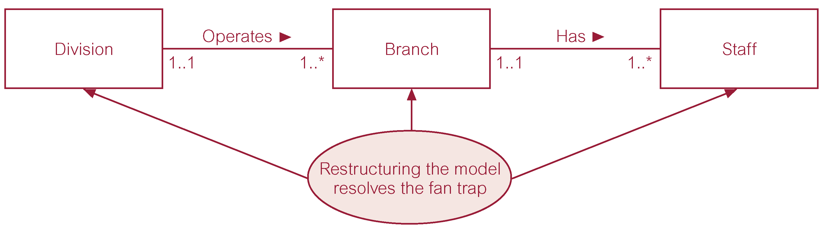
Restructuring ER model to remove Fan Trap

Slide 65
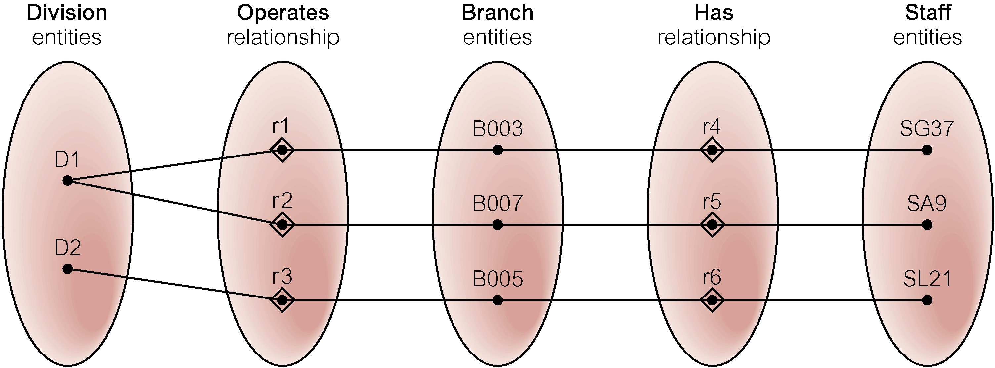
Semantic Net of Restructured ER Model with Fan Trap Removed
SG37 works at branch B003.

Slide 66

An Example of a Chasm Trap

Slide 67
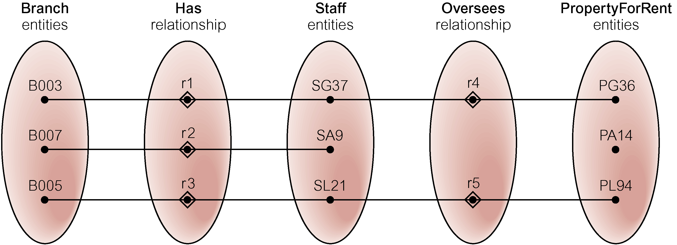
Semantic Net of ER Model with Chasm Trap
At which branch office is property PA14 available?

Slide 68
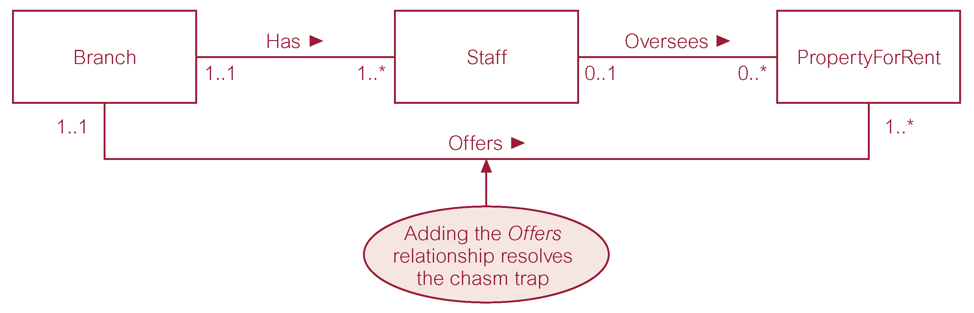
ER Model restructured to remove Chasm Trap

Slide 69
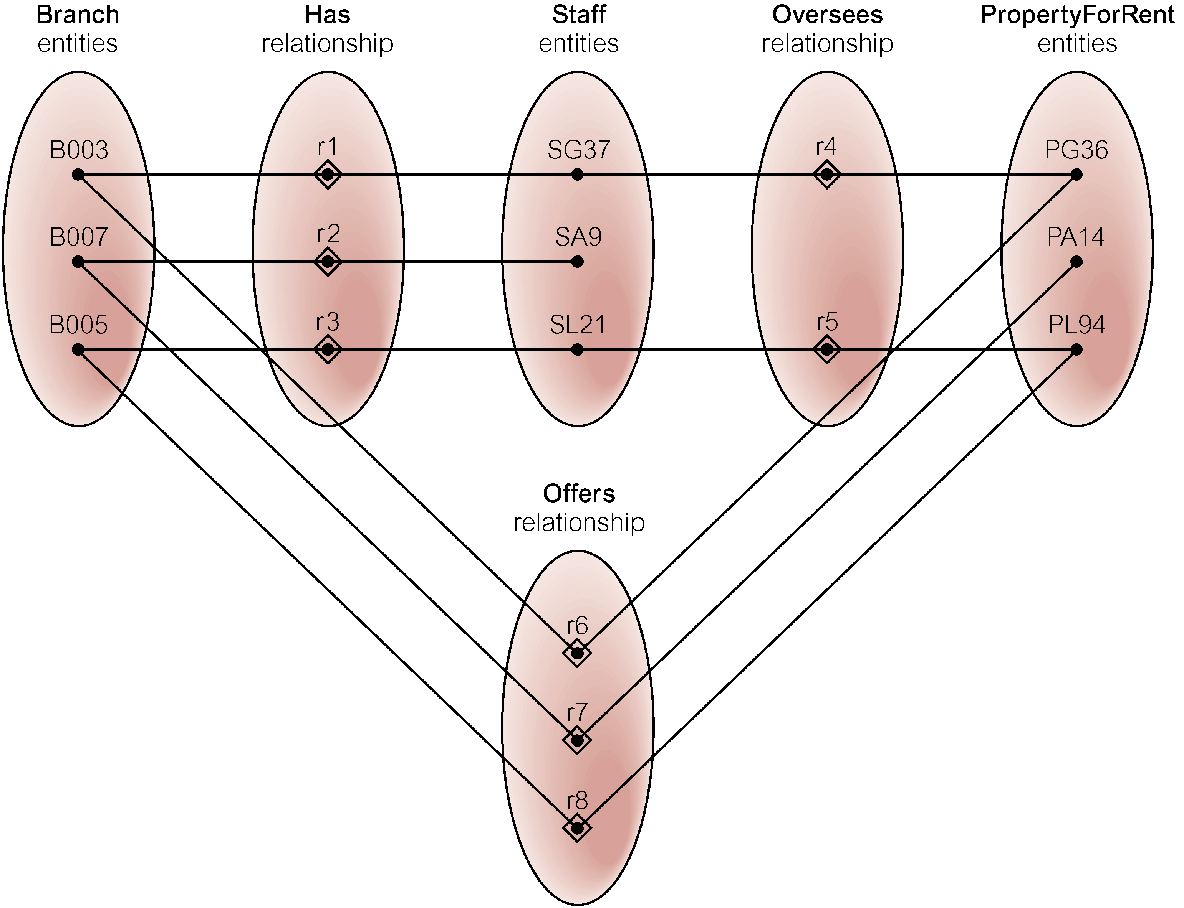
Semantic Net of Restructured ER Model with Chasm Trap Removed

